Slide 1
HTTP - The Backbone of the Web
Protocols

Slide 2
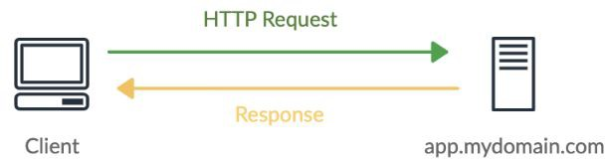
Introduction to HTTP
What is HTTP?
  Stands for HyperText Transfer Protocol
  The foundation of web communication
  Deﬁnes rules for requesting and transferring resources (e.g., web pages, APIs, images)
  Works over TCP/IP (Port 80 for HTTP, Port 443 for HTTPS)
Key Features:
  Text-based protocol (easy to read & debug)
  Stateless (each request is independent)
  Supports multiple methods (GET, POST, etc.)

Slide 3
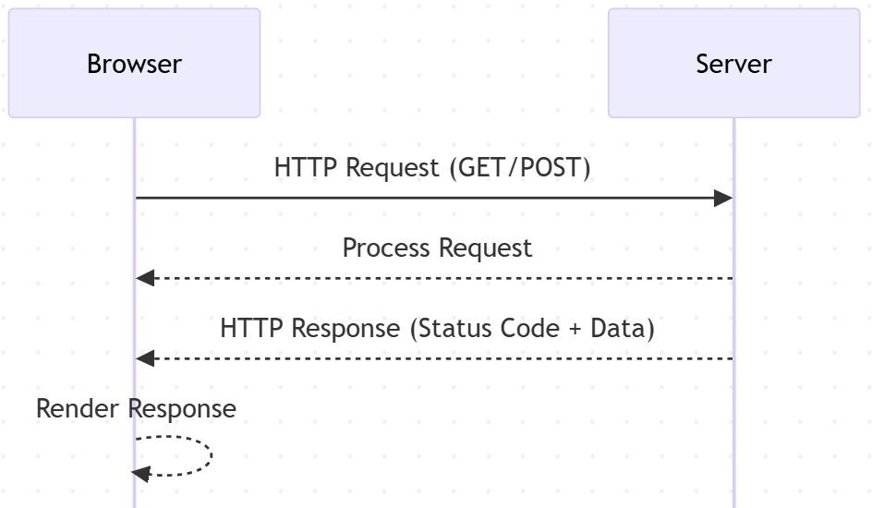
How HTTP Works
Client-Server Model:
  Client (browser or mobile app) makes an HTTP request
  Server (web server, API, etc.) processes the
request and sends back a response
Components of an HTTP Request:
  Method: Deﬁnes the action (GET, POST, etc.)
  URL: The resource being requested
  Headers: Metadata (e.g., user-agent, content type)
  Body (optional): Data sent in POST/PUT
requests
Components of an HTTP Response:
  Status Code: Indicates success or failure (e.g., 200 OK, 404 Not Found)
  Headers: Metadata about the response
  Body (optional): The actual content returned

Slide 4
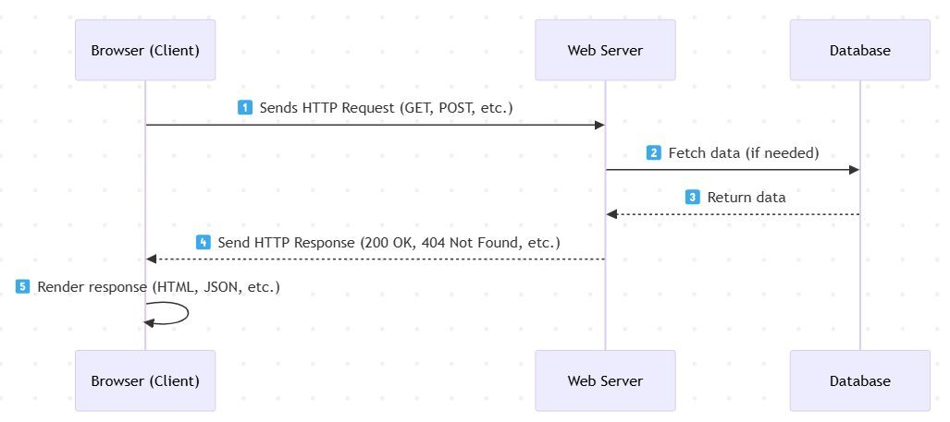
The HTTP Request-Response Cycle
Step 1: The browser (client) sends a request
Step 2: The web server processes the request
Step 3: The server generates a response and sends it back
Step 4: The browser renders the response (for a web page)

Slide 5
Stateless Nature of HTTP
What does “stateless” mean?
  HTTP does not retain memory of previous requests
  Each request is treated as an independent transaction
Challenges of Statelessness:
  Hard to maintain user sessions (e.g., login state)
  Each request must carry all necessary information
How do we handle state?
  Cookies – Small pieces of data stored in the browser
  Sessions – Server-side storage of user state
  Tokens (JWT, OAuth) – Used for authentication & authorization

Slide 6
HTTP Methods
Common HTTP Methods & Their Use Cases:
  GET: Retrieve a resource (e.g., webpage, API data)
  POST: Send data to create a new resource (e.g., form submission)
  PUT: Update an existing resource
  DELETE: Remove a resource
  PATCH: Partially update a resource

Slide 7
HTTP Status Codes
1xx – Informational (Request received, continuing process)
2xx – Success (Request successfully processed)
  200 OK – Successful response
  201 Created – Resource successfully created
3xx – Redirection (Further action needed)
  301 Moved Permanently – Resource URL changed
  304 Not Modiﬁed – Use cached version
4xx – Client Errors (Mistakes in the request)
  400 Bad Request – Incorrect request format
  401 Unauthorized – Authentication required
  403 Forbidden – No permission
  404 Not Found – Resource doesn’t exist
5xx – Server Errors (Issue with the server)
  500 Internal Server Error – Unexpected server failure
  503 Service Unavailable – Server overloaded

Slide 8
What About HTTPS?
HTTPS is the secure version of HTTP, using SSL/TLS encryption.
It ensures data conﬁdentiality, integrity, and authentication.
Used for secure websites, online banking, and e-commerce.
Works on Port 443 instead of Port 80.

Slide 9
HTTP Interview Questions
Basic Questions:
  What is HTTP, and how does it work?
  Why is HTTP considered a stateless protocol?
  What are the key diﬀerences between HTTP and HTTPS?
Intermediate Questions:
  Explain the HTTP request-response cycle with an example.
  What are HTTP methods? When would you use PUT vs. PATCH?
  What are HTTP status codes? Give examples of 2xx, 3xx, 4xx, and 5xx status codes.
Advanced Questions:
  How do cookies, sessions, and tokens help maintain state in HTTP?
  What is the diﬀerence between 301 (Moved Permanently) and 302 (Found) redirections?
  How does caching work in HTTP, and which headers control it?
  What security risks are associated with HTTP, and how can they be mitigated?

Slide 10
Summary & Key Takeaways
HTTP is the foundation of web communication
It follows a request-response model
HTTP is stateless, requiring mechanisms like cookies & sessions
HTTP methods deﬁne actions, and status codes indicate responses
What’s Next:
  REST & RESTfulness - API Design Principles

